Slide 1
How to install an IIS reverse proxy
before a working BIMcloud installation

Slide 2
Prerequisites
A working BIMcloud environment on Windows Server 2012 R2
Domain names (FQDN) properly set up in DNS (or in the hosts file for testing)
IP addresses of the BIMcloud Manager and the BIMcloud Server
For live systems, a proper SSL certificate
A working browser (IE Enhanced Security Configuration Off or Chrome installed)

Slide 3
Installation tasks
Install IIS (if it is not yet installed)
Import/create the necessary SSL certificate
Download and install the Application Request Routing module of IIS Manager
Enable the proxy
Bind HTTPS to the site using the SSL certificate
Define the necessary URL rewrite rules

Slide 4
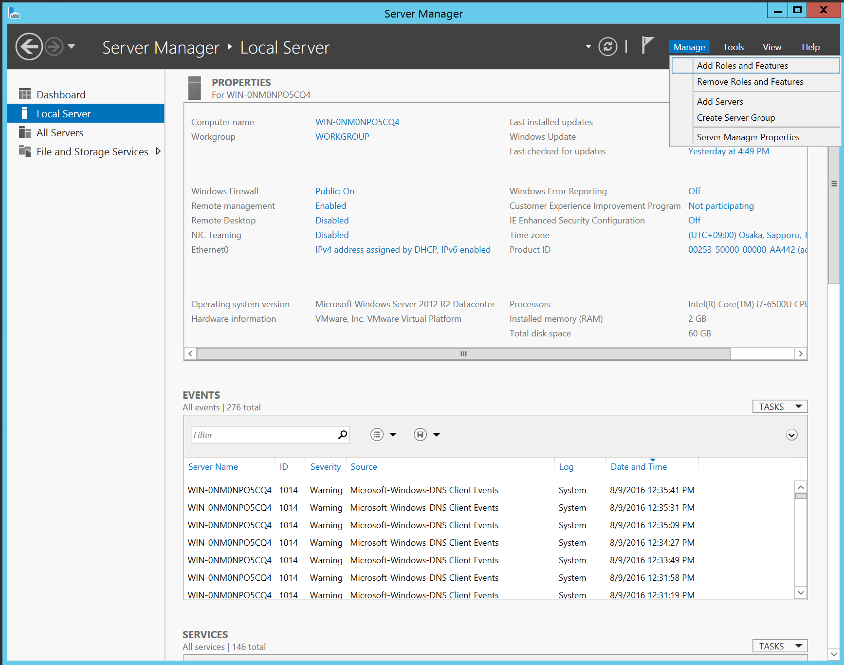
Install IIS
Start Server Manager.
Choose Add Roles and Features.

Slide 5
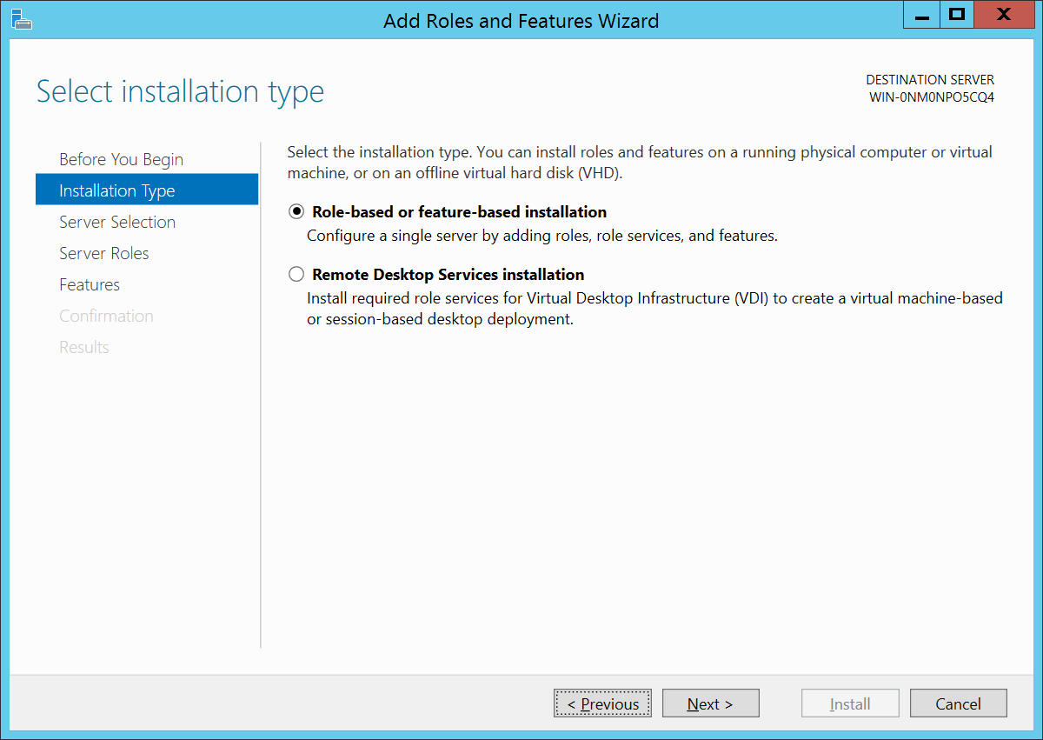
Install IIS
Choose Role-based or feature-based installation.
Click Next.

Slide 6
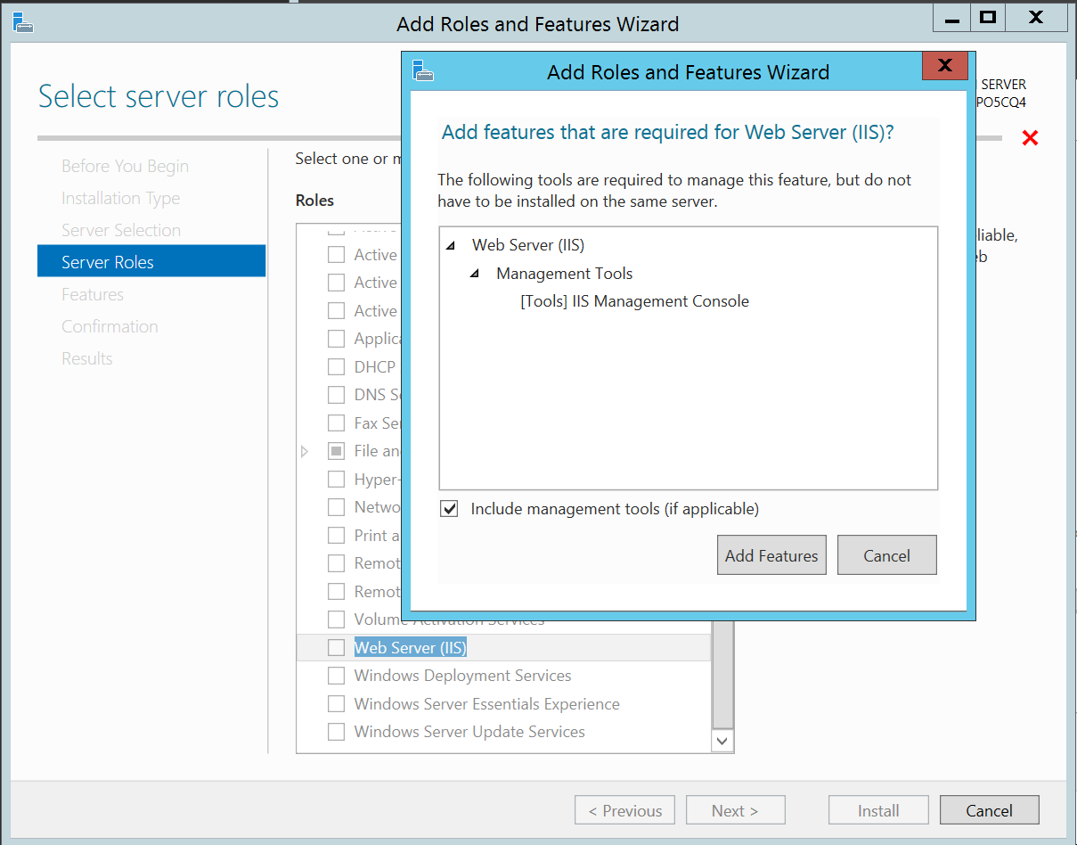
Install IIS
Start Server Manager.
Choose Add Roles and Features.
Click Add Features.

Slide 7
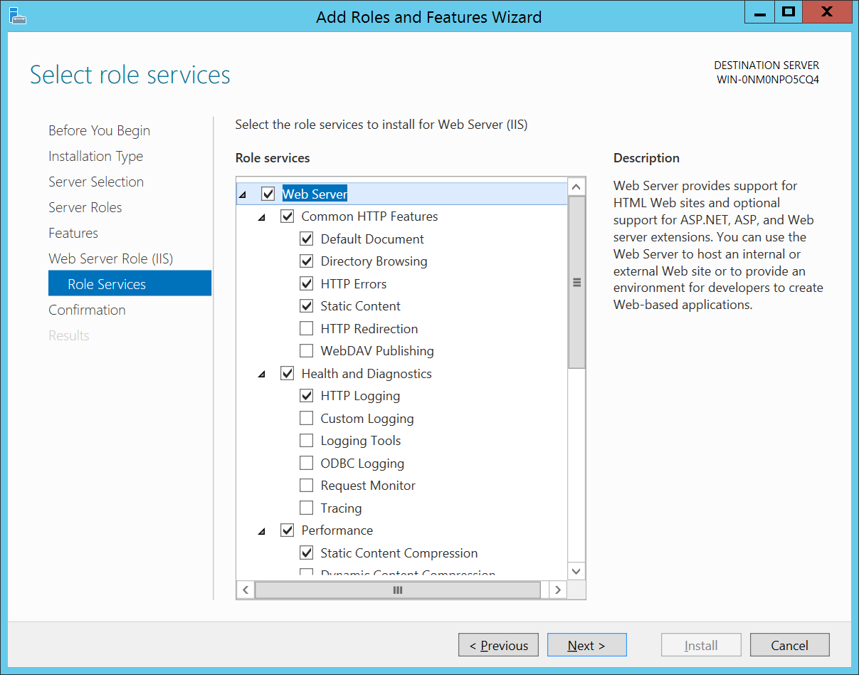
Install IIS
Select the Web Server (IIS) role. The default settings are fine, don’t install HTTP redirection.
Click Next.

Slide 8
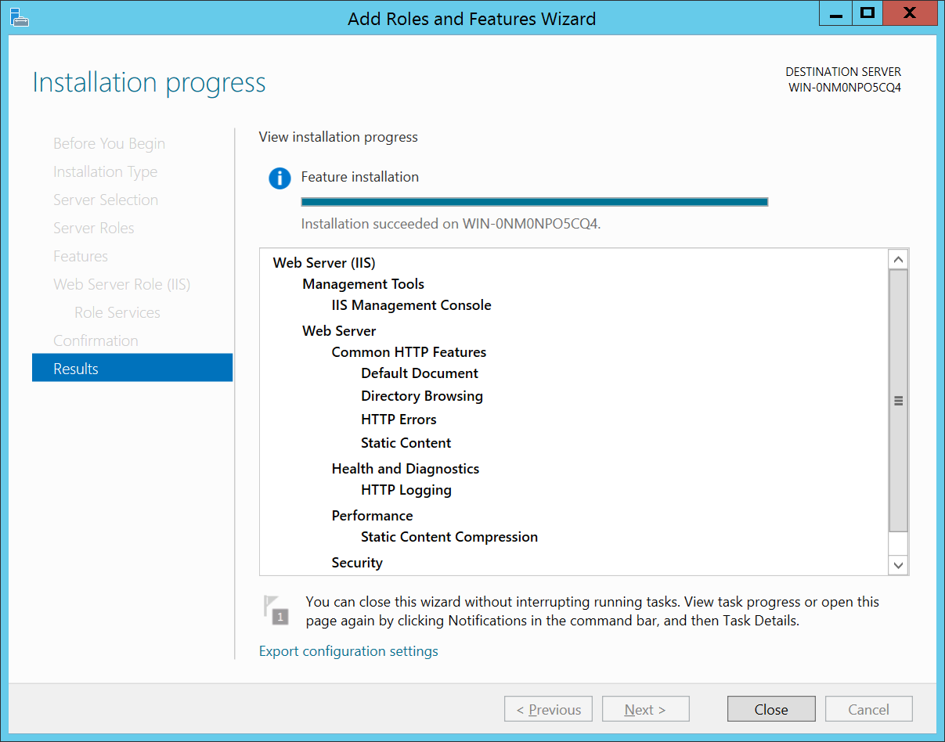
Install IIS
If everything went fine, you should see a screen like this.
Click Close.

Slide 9
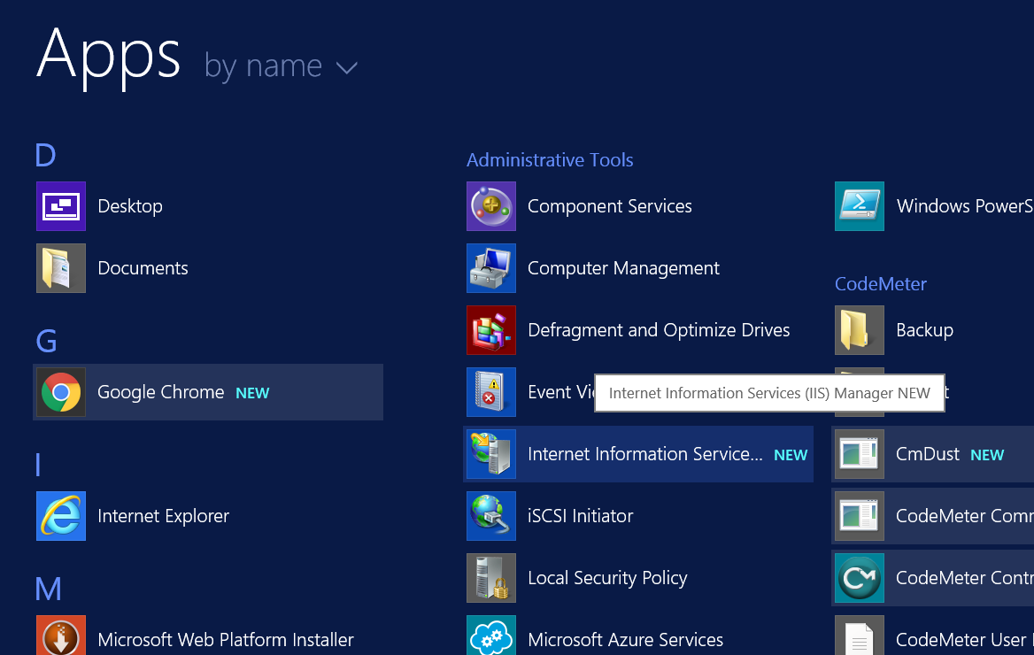
Configure IIS
Start Internet Information Services (IIS) Manager.
You’ll be using it a lot, so you may want to pin it to the Taskbar or the Start menu. Also, you can start it fast by hitting Windows-R and then typing inetmgr.

Slide 10
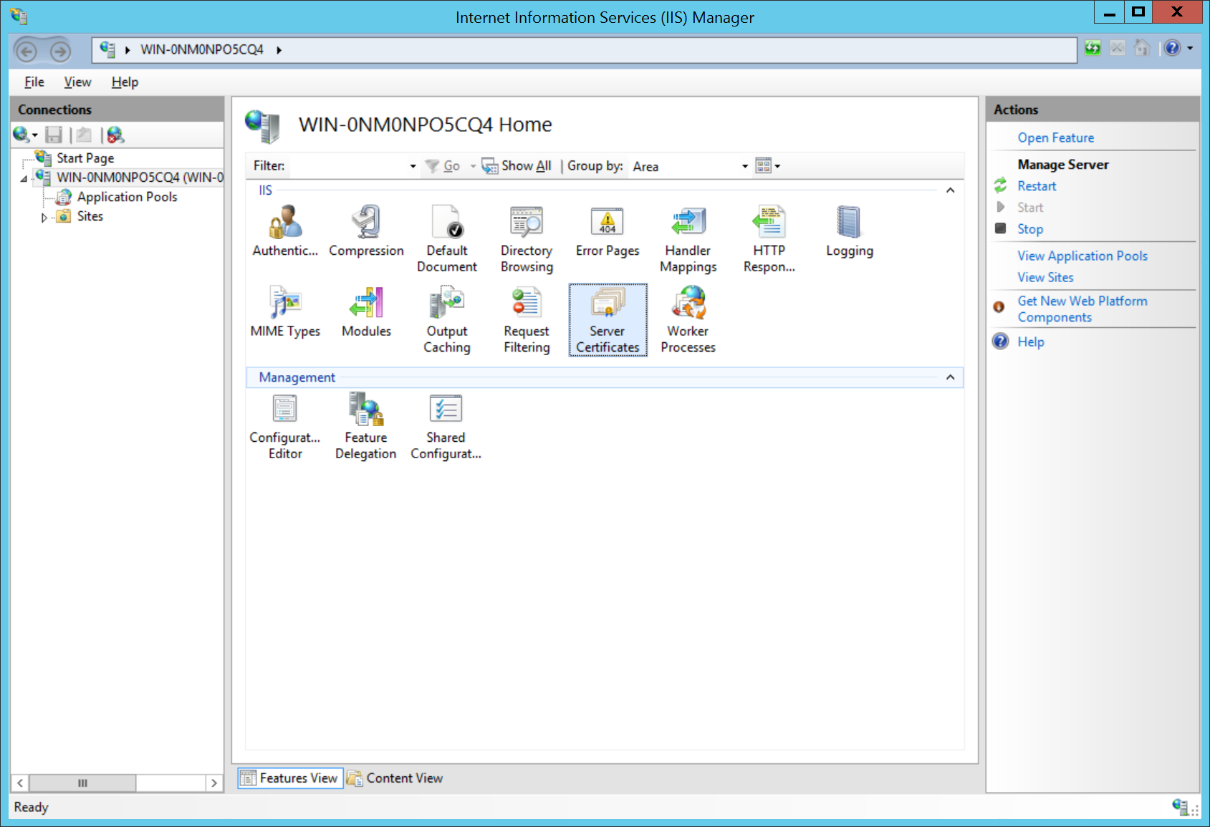
Import/create server certificates
Open Server Certificates.

Slide 11
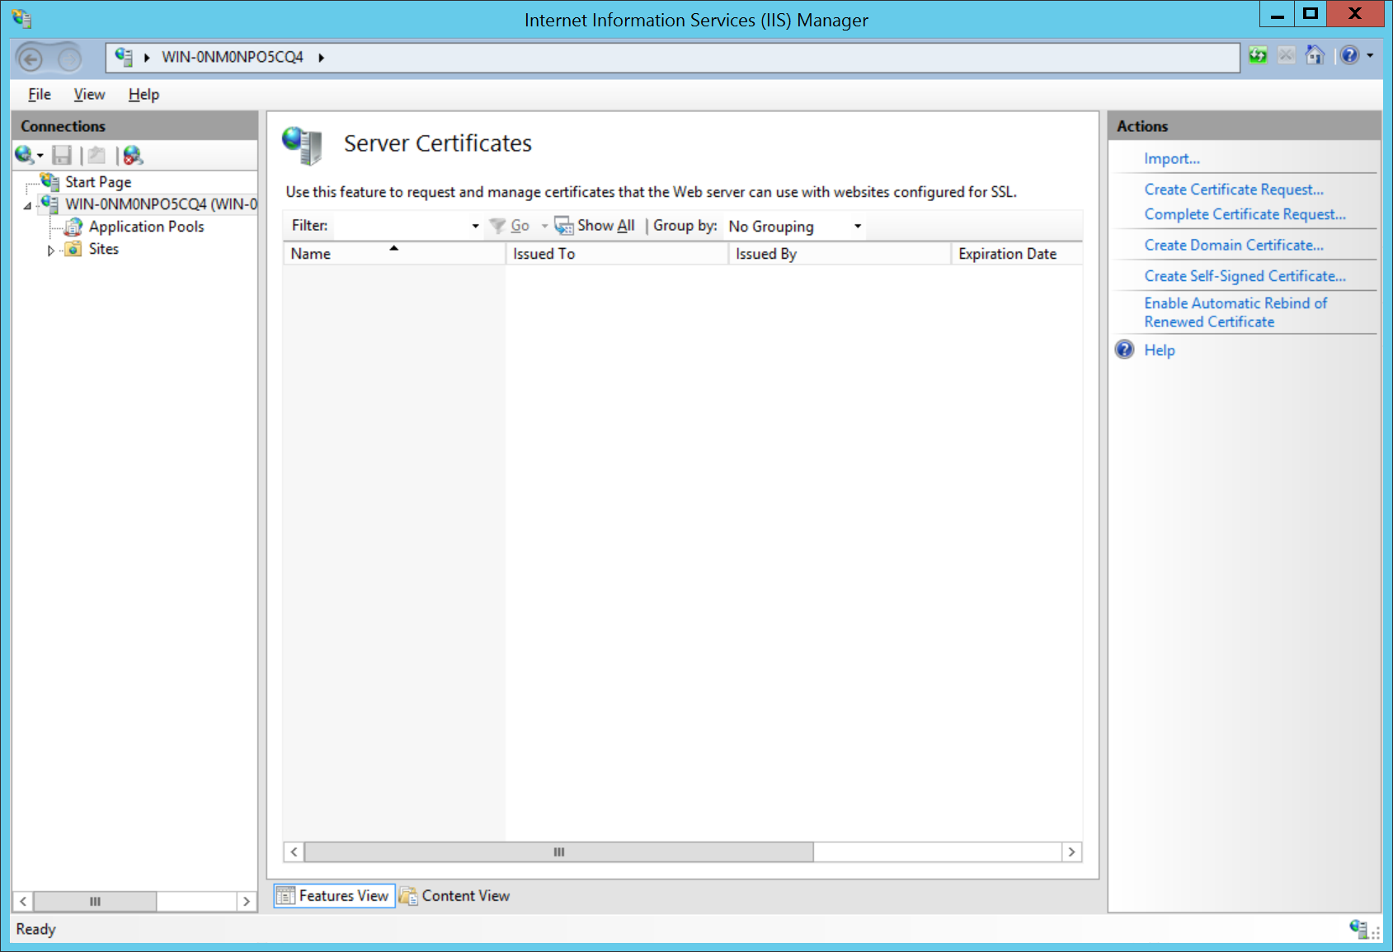
Import/create server certificates
In a live environment, use Import… to import your purchased SSL certificate. Here we’ll create a self-signed certificate for testing.
Click Create Self-Signed Certificate.

Slide 12
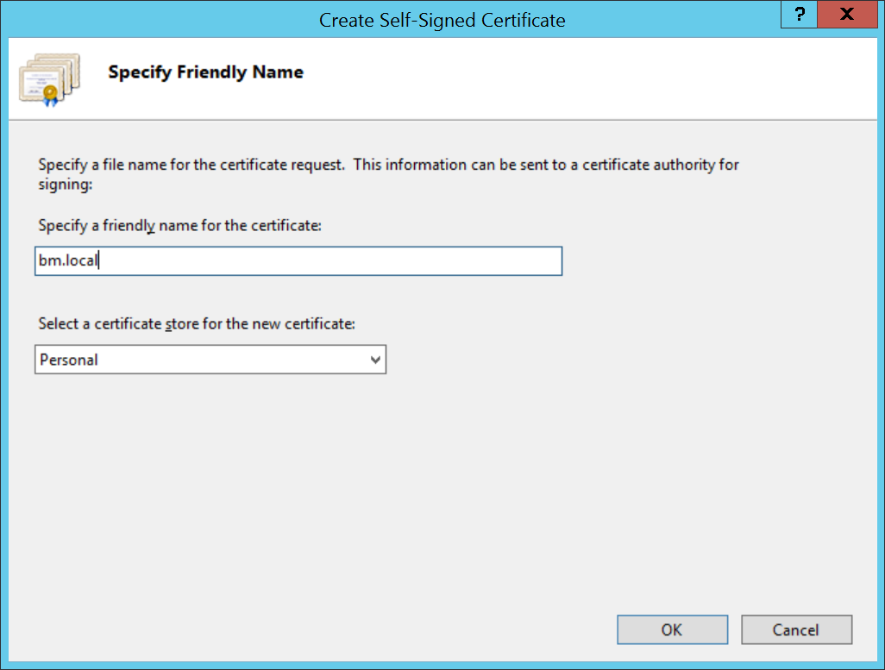
Import/create server certificates
To remember it more easily, use your FQDN as the friendly name for the certificate. In this example we use bm.local but in reality it would be a more “proper” name like gandalf.chinabim.com
Click OK.

Slide 13
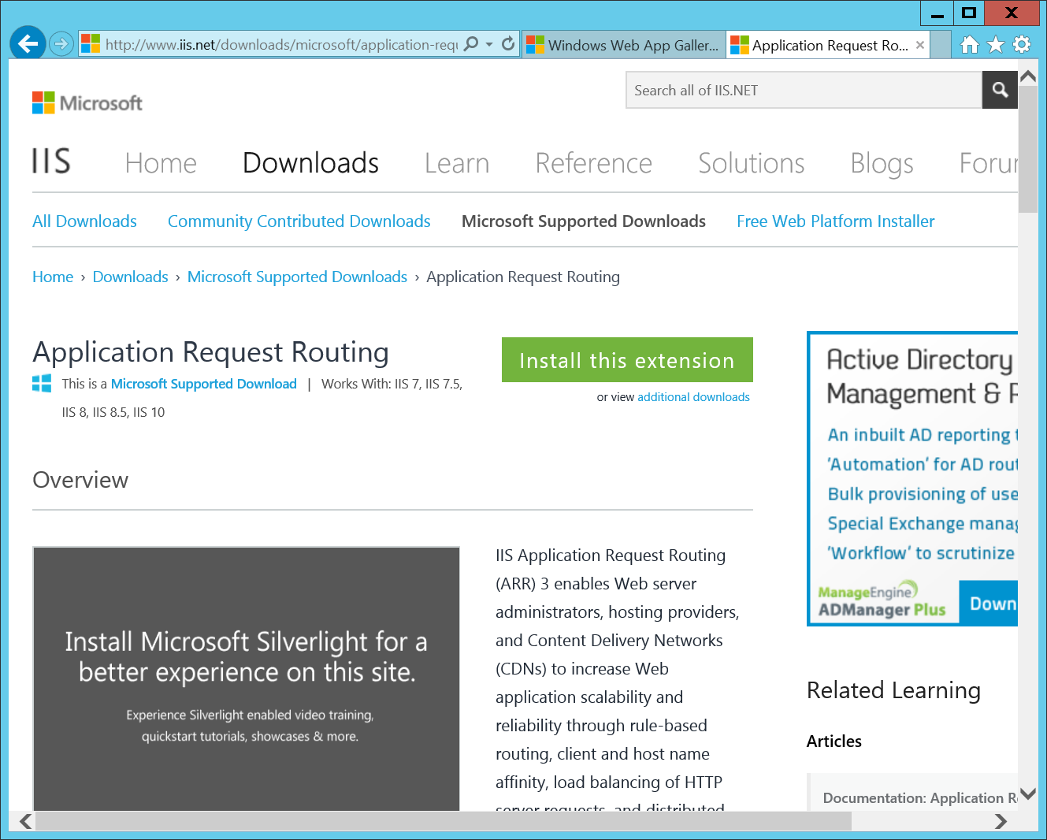
Download Application Request Routing
Now you’ll need to add some modules to IIS.
Open http://www.iis.net/downloads/Microsoft/application-request-routing.
Click on Install this extension.

Slide 14
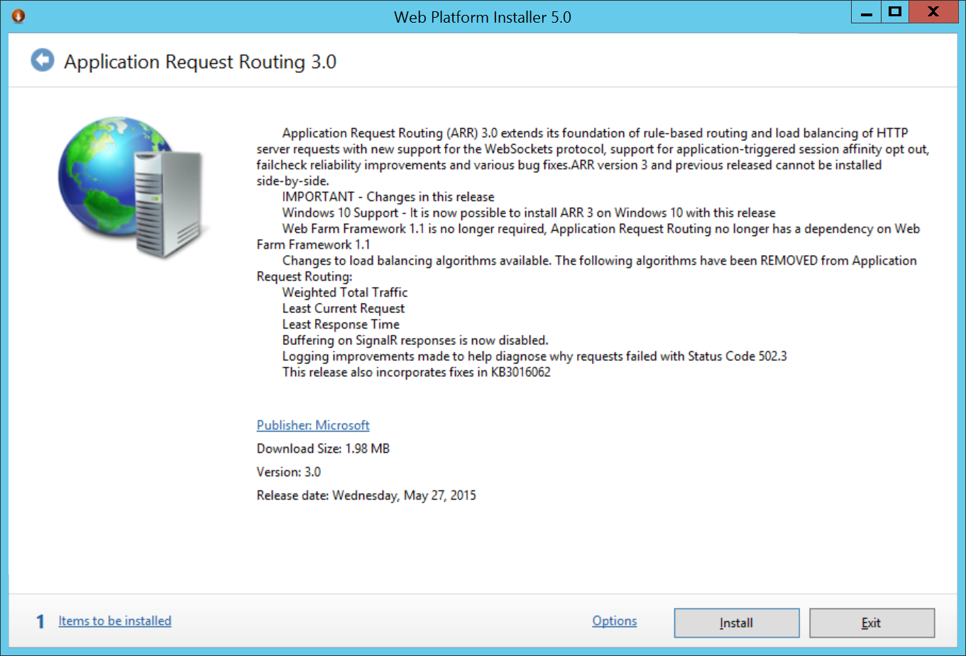
Install ARR
Click Install.
ARR will also install another important IIS module called URL Rewrite.

Slide 15
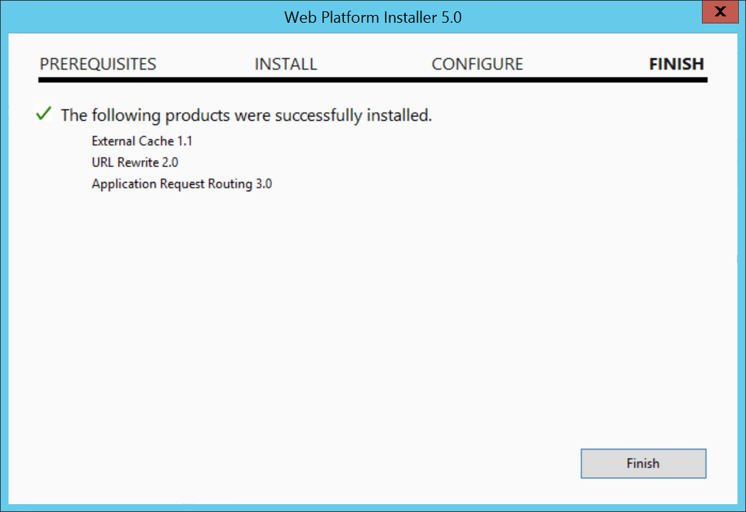
Install ARR
If everything went fine, you’ll see this screen.
Click Finish.

Slide 16
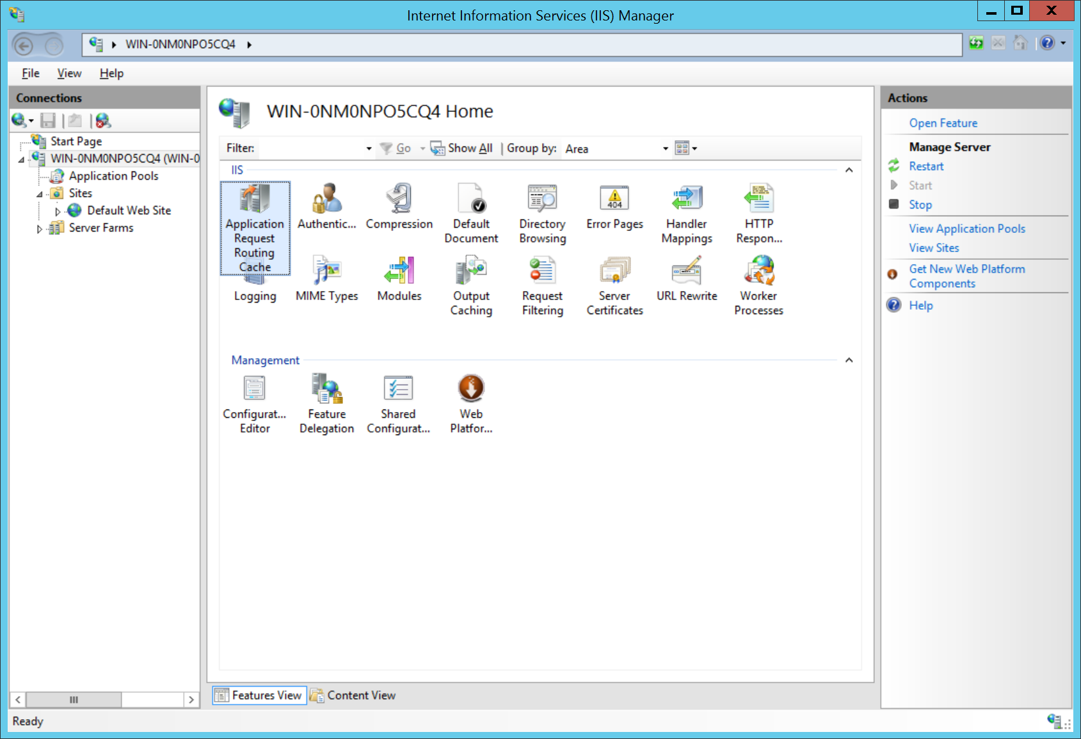
Enable the proxy
Select (and double-click) the Application Request Routing Cache Module in the IIS Manager.

Slide 17
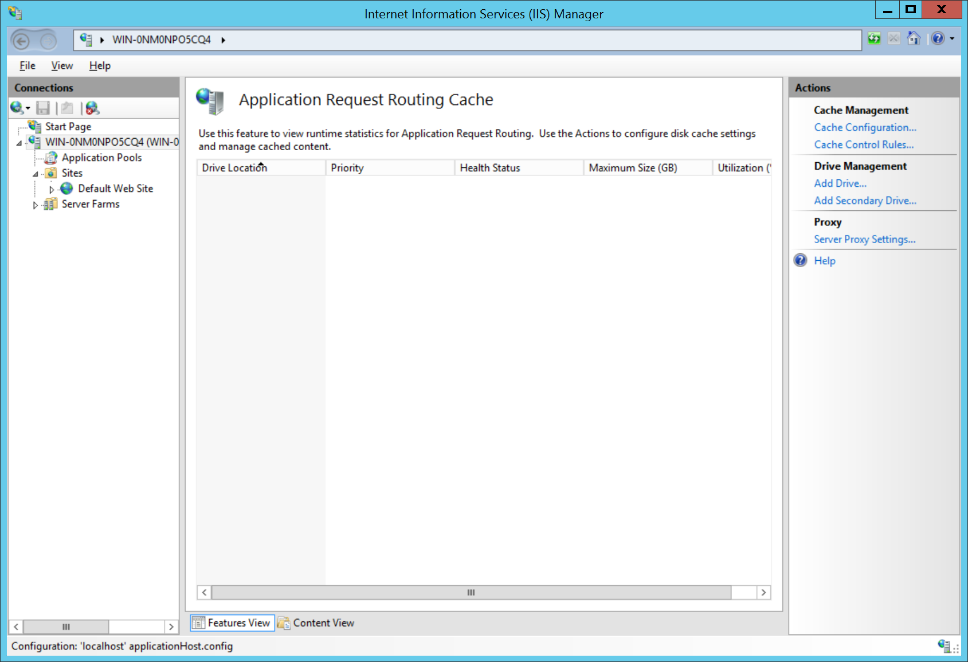
Enable the proxy
Click on Server Proxy Settings.

Slide 18
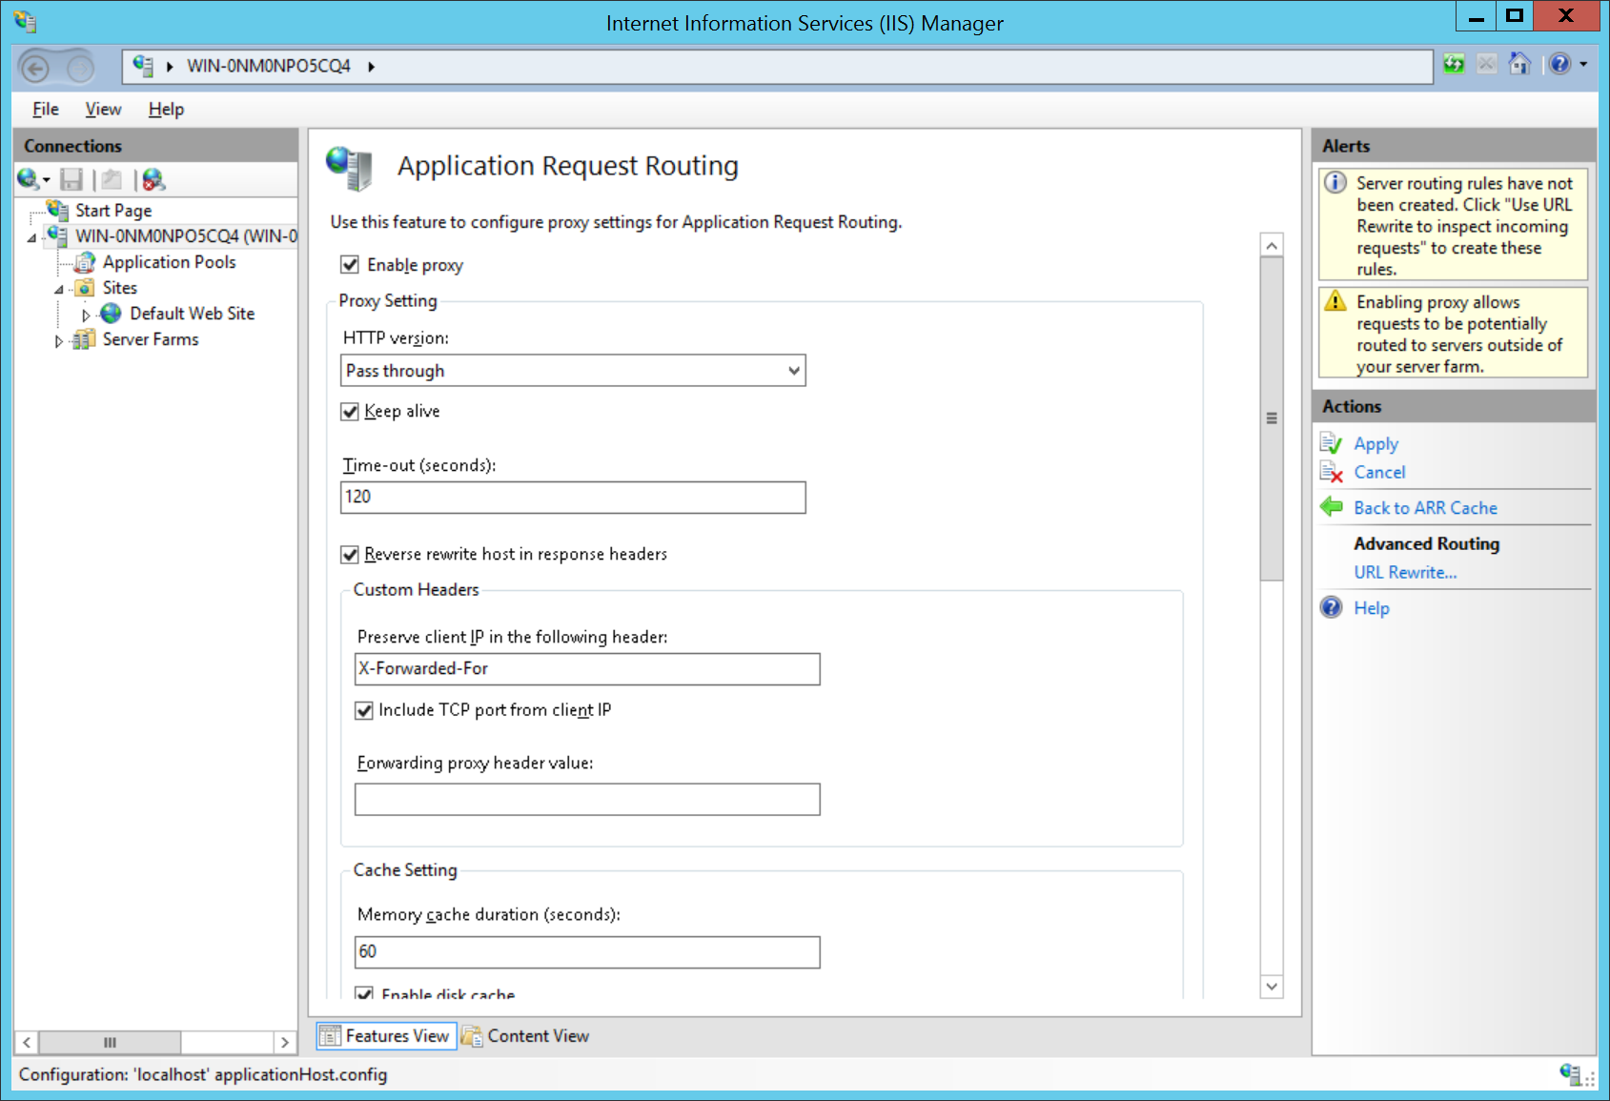
Enable the proxy
Check Enable proxy.

Slide 19
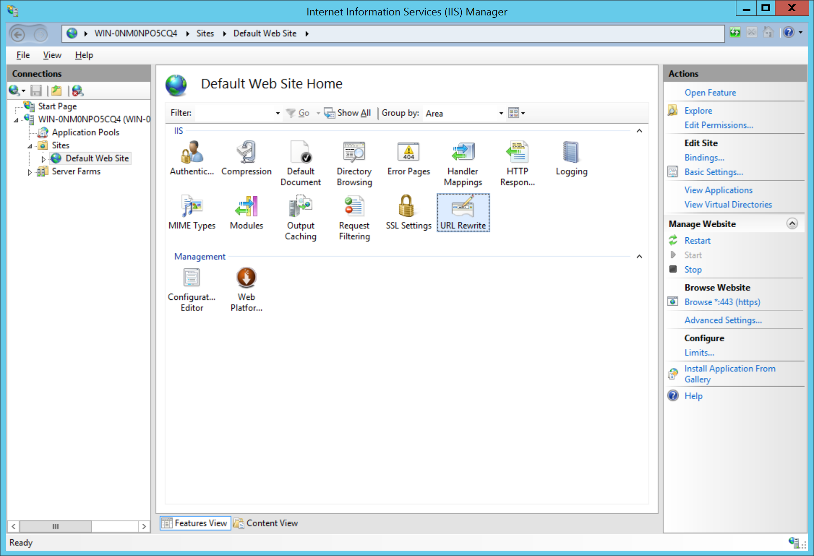
Bind HTTPS to the site
Select the web site in IIS Manager that you want to configure (on the left side). Here we use the default site but it can be any other.
Click on Bindings (on the right side).

Slide 20
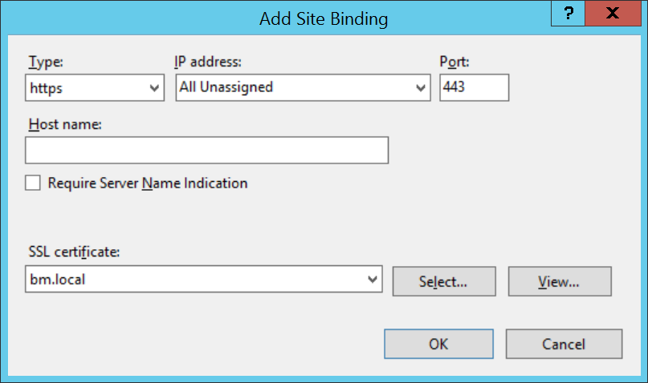
Bind HTTPS to the site
Click on Add.
Select https from the Type drop-down menu.
Select your certificate (the one you imported or created) from the SSL certificate drop-down menu.
Click OK.

Slide 21
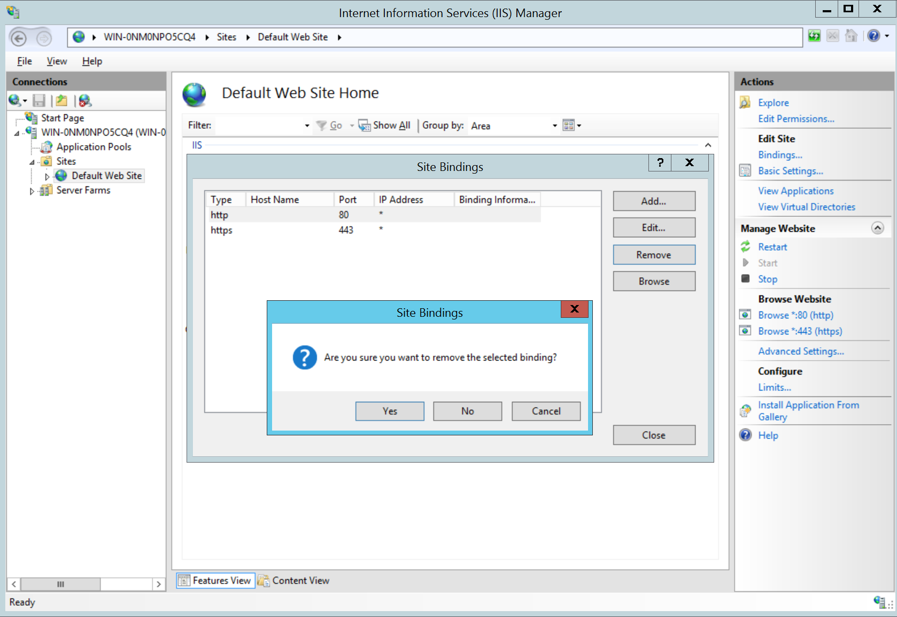
Unbind HTTP
If there is a line for Port 80 (like with the Default Web Site), select it.
Click Remove.
Answer Yes to the question.

Slide 22
Define rewrite rules
Select (and double-click) the URL Rewrite Module in the IIS Manager.

Slide 23
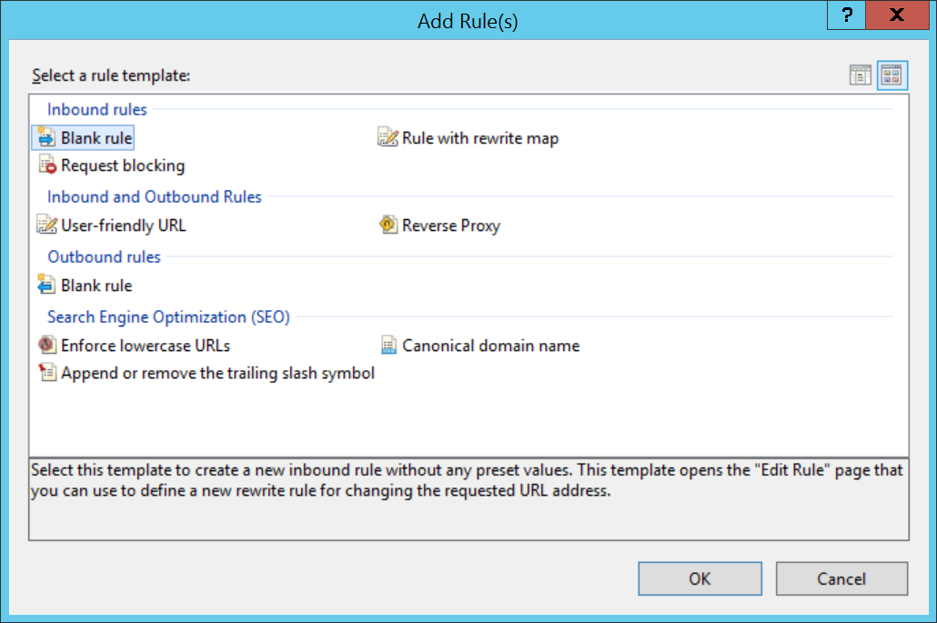
Define rewrite rules
Click on Add Rule(s).
Choose Blank rule (and NOT the Reverse Proxy rule).
Click OK.

Slide 24
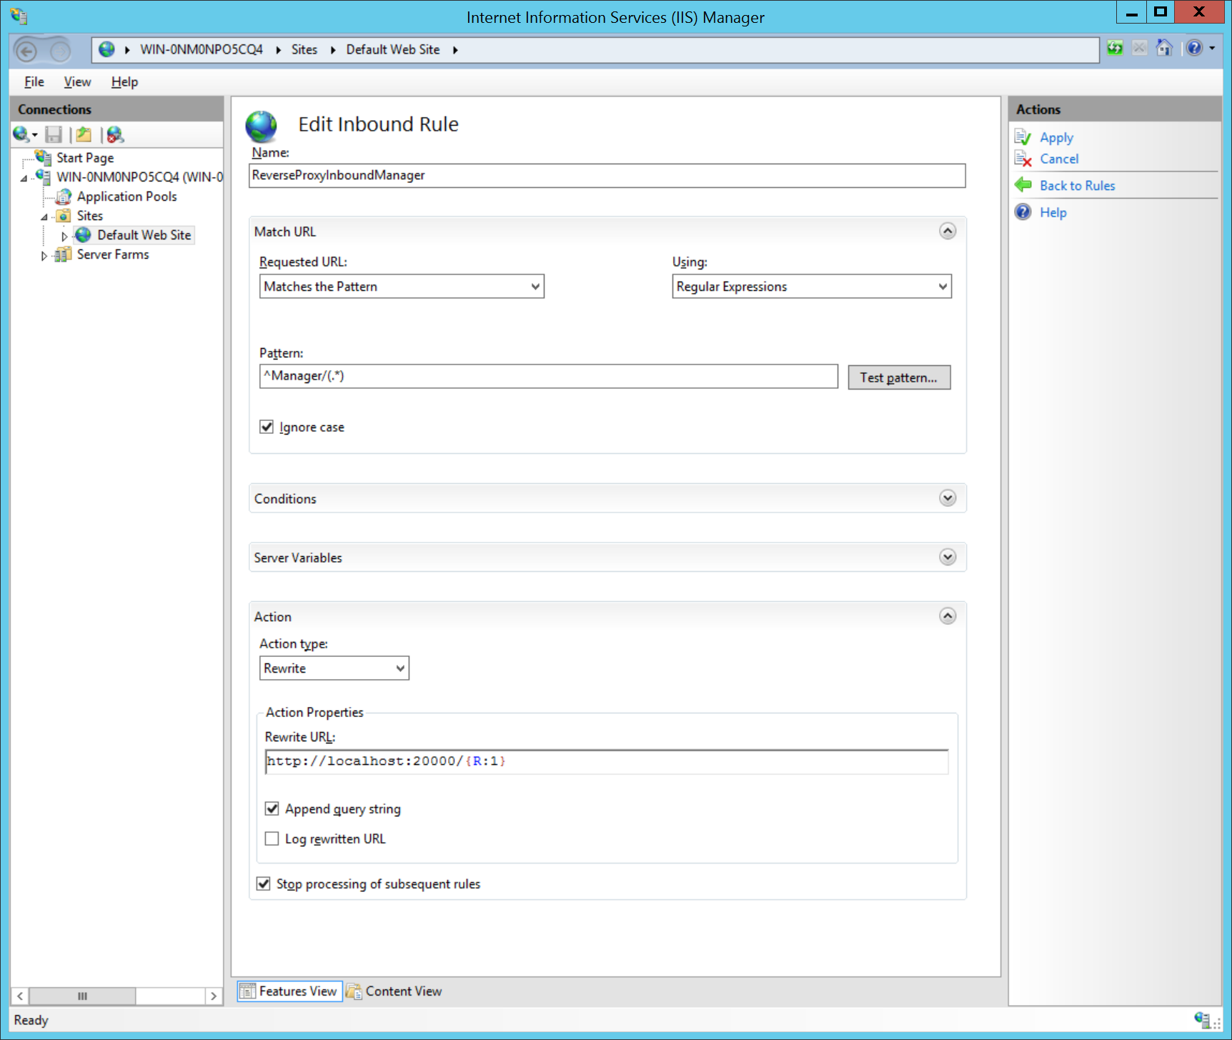
Define rewrite rules
Choose a friendly name that identifies the rule. This rule will redirect https://bm.local/Manager to the real Manager address.
Enter ^Manager/(.*) in the Requested URL field.
Enter the actual Manager address (plus /{R:1}) in the Rewrite URL field. In our case the Manager is working on the same machine, using Port 20000. So we’ll enter http://localhost:20000/{R:1} in the field.

Slide 25
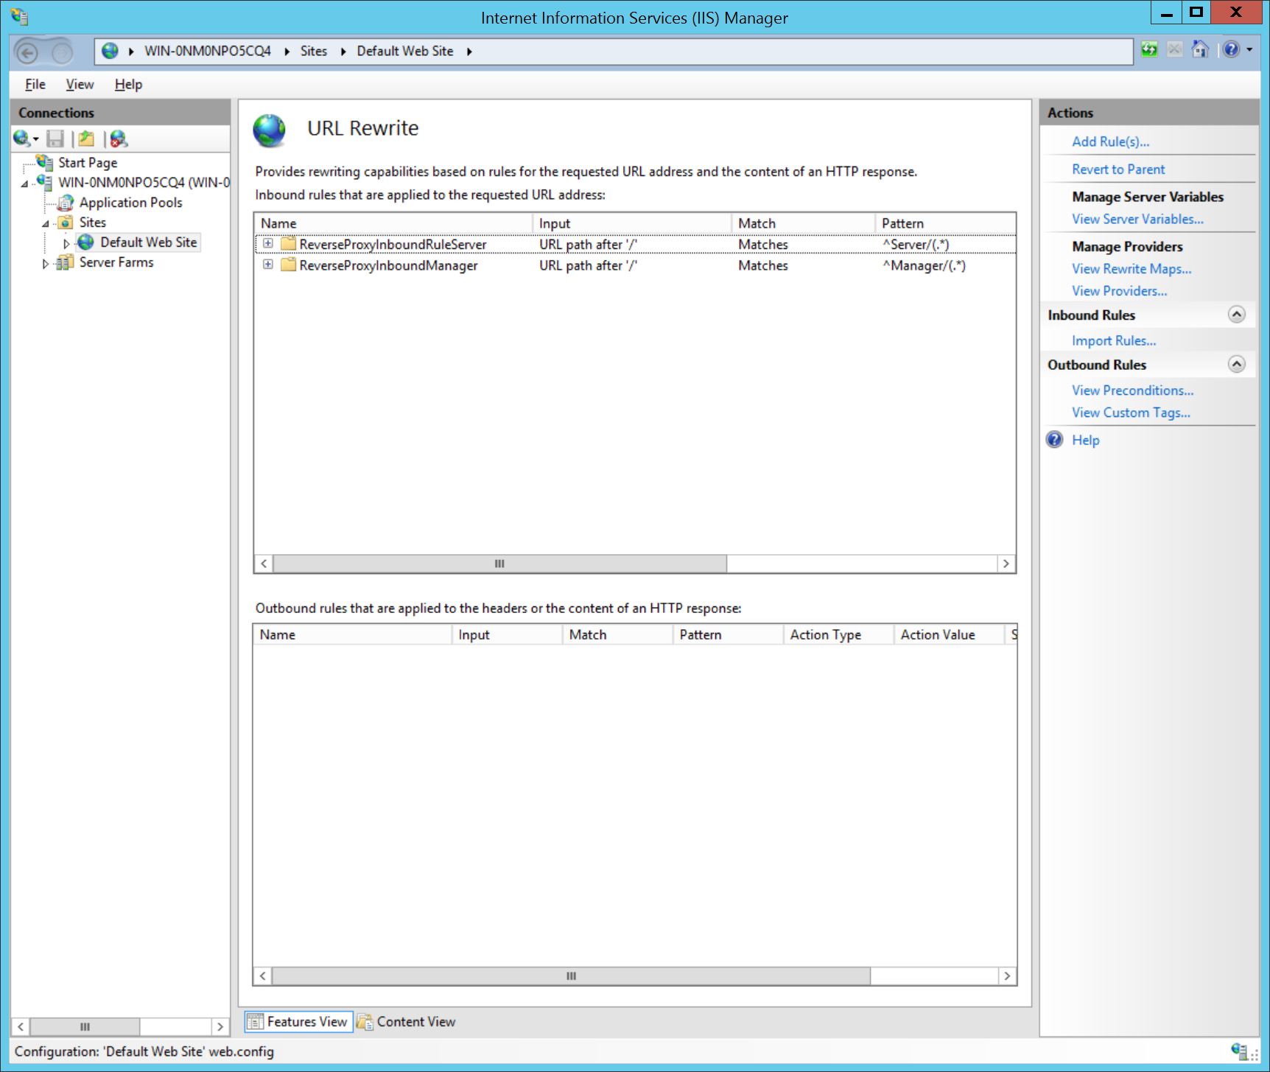
Define rewrite rules
Create one or more similar rewrite rule(s) for the BIMcloud Server(s). In our case, we have only one BIMcloud Server and on the same machine but you may have more. In this example we used /Server as the proxy redirection pattern.

Slide 26
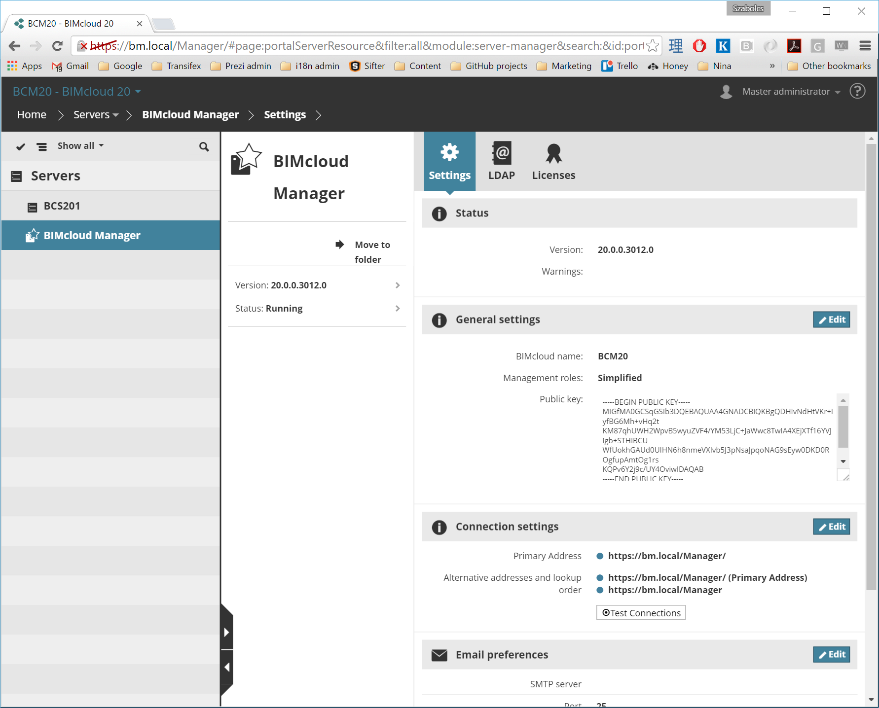
HTTPS is working
If everything went fine, you should be able to use BIMcloud via HTTPS. Please set up the HTTPS addresses in the BIMcloud Manager and make sure you don’t forget the trailing slash (/) from the addresses. It won’t work without them.

